Slide 1

NLP Text pre-processing techniques
Presented by:
Elizer Ponio Jr.
Department of Computer Science
College of Computing and Information Technologies

Slide 2
Outline
What is Natural Language Processing
Why is NLP important
Text pre-processing
Steps in text pre-processing

Slide 3
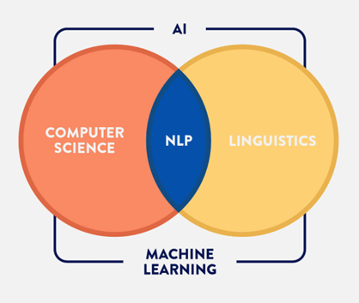
What is Natural Language Processing?
Natural Language Processing, or NLP for short, focuses on analyzing text and speech data.
This can range from:
Simple recognition (what words are in the given text/speech)
Sentiment analysis (was a review positive or negative)
Text generation (Writing a song or lyrics from scratch).

Slide 4
Why NLP is important
Sentiment Analysis

Slide 5
Why NLP is important
Machine Translation

Slide 6
Why NLP is important
Sentiment Analysis

Slide 7
Why NLP is important
Voice Assistant

Slide 8
Why NLP is important
Smart Speaker

Slide 9
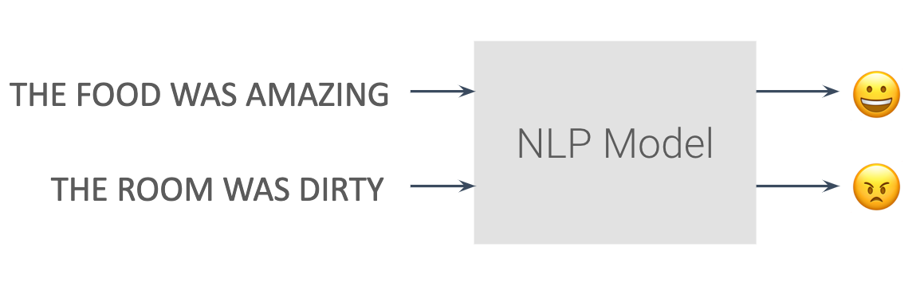
Sentiment Analysis Example

Slide 10
Text pre-processing
Text pre-processing refers to a series of techniques used to clean, transform and prepare raw textual data into a format that is suitable for NLP or ML tasks.

Slide 11
Steps in Text pre-processing
Lower Casing
Tokenization
Removing punctuation marks, special characters, URLs and digits
Stop Word Removal
Stemming
Lemmatization
Count Vectorizer and TF-IDF

Slide 12
Converting Text to Lowercase
When we have a text input, such as a paragraph we find words both in lower as well as upper case. However, the same words written in different cases are considered as different words by the computer.
For example, “Free” and “free” are considered as two separate words by the computer even though they mean the same.
[”Free”] → [“free”]

Slide 13
Stop Word Removal
Stopwords such as “is”, “a”, “an”, “the”, “for” does not add much value to the meaning of a document and can help focus on the most important information or words.
It can reduce the size of the dataset, which in turn reduces the training time required for natural language processing models.
[”I see a cute dog”] → [“see cute dog”]

Slide 14
Removing URL’s, Digits and Special Characters
URLs or links to webpages, digits and special characters
These do not add any value to text data and therefore should be removed before processing.
[”Please visit www.youtube.com”] → [“Please visit”]
[”I have $5.00 in my account”] → [“I have in my account”]

Slide 15
Tokenization
Tokenization is the process of breaking down large blocks of text such as paragraphs and sentences into smaller, more manageable units.
[”I see a cute dog”]
[”I”, “see”, “a”, “cute”, “dog”]

Slide 16
Stemming
Stemming is the process of reduction of a word into its root or stem word.
connecting
connects
connect
connection

Slide 17
Stemming
Stemming simply cuts the end of words to get the root form. Because of this, it returns a word that is not part of the English vocabulary
Changing
Changed
Chang
Change

Slide 18
Lemmatization
Lemmatization goes beyond simple word reduction and considers the context of a word in a sentence. It analyzes the part of speech and meaning to accurately convert words to their base form. A lemma is the base form or dictionary form of a word.
Changing
Changed
Change
Change

Slide 19
Count Vectorizer
CountVectorizer is used to convert text data into numerical form.
This creates a bag of words where each word is treated as a separate feature and the count of each word in a given document is used as the value of that feature.

Slide 20
Count Vectorizer
[‘The cat sat’,
‘The cat sat in the hat’,
‘The cat with the hat’]

Slide 21
Count Vectorizer
Apply stop word removal and lemmatization before doing Count Vectorizer
 | Document
0 | Cat sat
1 | Cat sat hat
2 | Cat hat

Slide 22
Count Vectorizer
Word | Frequency
cat | 3
sat | 2
hat | 2

Slide 23
Count Vectorizer
 | cat | hat | sat
cat sat | 1 | 0 | 1
cat sat hat | 1 | 1 | 1
cat hat | 1 | 1 | 0

Slide 24
TF-IDF Vectorizer
TD-IDF Vectorizer is also used to convert text data into numerical form.
TF-IDF Vectorizer not only counts the frequency of each word but also assigns a weight to each word based on its frequency in the document and its frequency in the entire corpus

Slide 25
TF-IDF Vectorizer
TF stands for
Term Frequency
IDF stands for
Inverse Document Frequency

Slide 26
TF-IDF Vectorizer
['It is going to rain today’,
'I am not going to office today’,
'I am going to watch a football match']

Slide 27
TF-IDF Vectorizer
 | Document
0 | It is going to rain today
1 | I am not going to office today
2 | I am going to watch a football match

Slide 28
TF-IDF Vectorizer
Apply stop word removal and lemmatization before doing TF-IDF Vectorizer
 | Document
0 | go rain today
1 | go office today
2 | go watch match

Slide 29
TF-IDF Vectorizer
Word | Frequency
go | 3
rain | 1
today | 2
office | 1
watch | 1
football | 1
match | 1

Slide 30
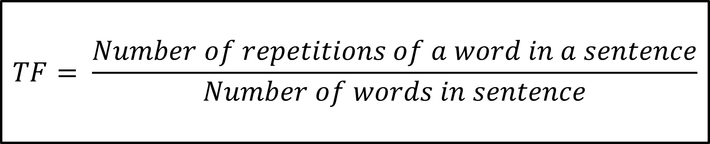
Computing Term Frequency
$$TF= \frac{Number of repetitions of a word in a sentence}{Number of words in sentence}$$

Slide 31
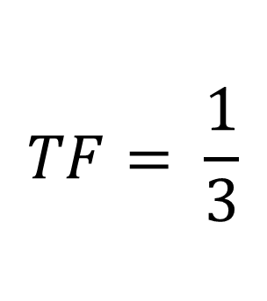
Computing TF
For example, the TF of the word “go” for the sentence “go rain today” is calculated as:
$$TF= \frac{1}{3}$$
1 is the number of times “go” appeared in “go rain today”
3 is the total number of words in “go rain today”

Slide 32
Computing TF
Word | TF of sentence “go rain today” | TF of sentence “go office today” | TF of sentence “go watch football match”
go | 1/3 | 1/3 | 1/4
rain | 1/3 | 0 | 0
today | 1/3 | 1/3 | 0
office | 0 | 1/3 | 0
watch | 0 | 0 | 1/4
football | 0 | 0 | 1/4
match | 0 | 0 | 1/4

Slide 33
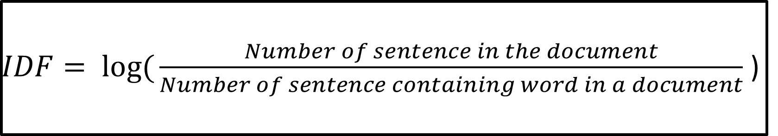
Computing Inverse Document Frequency
$IDF= log({\frac{Number of sentence in the document}{Number of sentence containing word in a document}}$ )

Slide 34
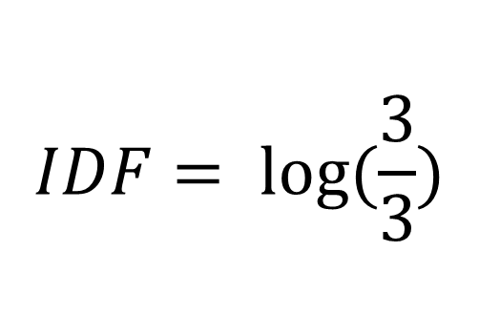
Computing Inverse Document Frequency
For example, for the word “go” the IDF is calculated as:
$$IDF= \log{(\frac{3}{3}})$$
3 is the total number of sentences
3 is the number of times the word “go” appeared in all sentences

Slide 35
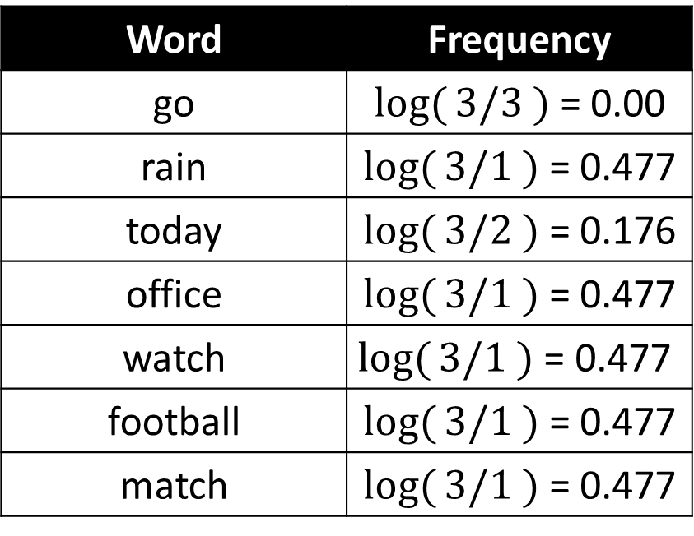
Computing Inverse Document Frequency
Word | Frequency
go | $log({3/3} )$ = 0.00
rain | $log({3/1} )$ = 0.477
today | $log({3/2} )$ = 0.176
office | $log({3/1} )$ = 0.477
watch | $$log({3/1} ) \text{= 0.477}$$
football | $log({3/1} )$ = 0.477
match | $log({3/1} )$ = 0.477

Slide 36

Computing TF-IDF
$$TFIDF = TF ∗ IDF$$

Slide 37
Computing Inverse Document Frequency
Sentence | go | rain | today | office | watch | football | match
go rain today | 1/3 * 0 | 1/3 * 0.477 | 1/3 * 0.176 | 0 * 0.477 | 0 * 0.477 | 0 * 0.477 | 0 * 0.477
go office today | 1/3 * 0 | 0 * 0.477 | 1/3 * 0.176 | 1/3 * 0.477 | 0 * 0.477 | 0 * 0.477 | 0 * 0.477
go watch football match | 1/4 * 0 | 0 * 0.477 | 0 * 0.176 | 0 * 0.477 | 1/4 * 0.477 | 1/4 * 0.477 | 1/4 * 0.477

Slide 38
Computing Inverse Document Frequency
Sentence | go | rain | today | office | watch | football | match
go rain today | 0 | 0.159 | 0.059 | 0 | 0 | 0 | 0
go office today | 0 | 0 | 0.059 | 0.159 | 0 | 0 | 0
go watch football match | 0 | 0 | 0 | 0 | 0.119 | 0.119 | 0.119

Slide 39
References
https://medium.com/@maleeshadesilva21/preprocessing-steps-for-natural-language-processing-nlp-a-beginners-guide-d6d9bf7689c9

